Slide 1
Practice Lab:
This Practice Lab is dependent on Discussion Module 7451, where most of the objects we create in this lab were introduced.
This Practice Lab requires a working DSE system, with DSE Search enabled, and with ability to execute CQL DDL.
No command line prompt is required.
All commands are run from CQLSH, or DSE Studio.
DSE Search, Query Syntax, Facets, other
Notes:
The goal of this Practice Lab is to create an Amazon like facet query presentation.
Runtime requirements are detailed in the slide above.

Slide 2
Challenge 1: Be Amazon
Create the runtime environment to support the query “computer mouse”, and return a faceted set of results similar to those in the image on the left. (A query response is okay; no Html required.)
Design and create the tables, data, indexes, and query.
The (data model) should be generic, so that you can also satisfy the query “Volvo accessories”, and get an appropriate facet response.
You can use a non-tokenized key value for the initial query.
Notes:
Design and deliver the runtime statements and query to deliver the above-

Slide 3
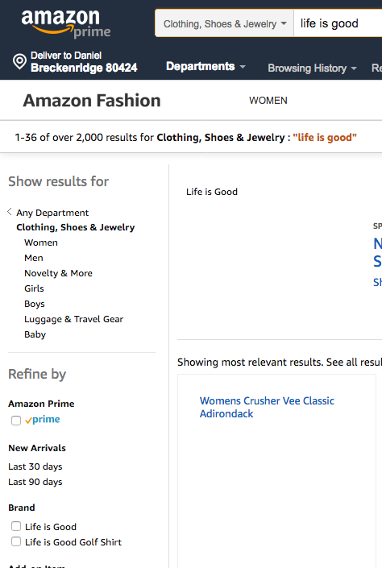
Challenge 1: Be Amazon
The (data model) should be generic, so that you can also satisfy the query “Life is Good”, and get an appropriate facet response.
(In other words; prove that your model works with more than once product.)
Notes:
Design and deliver the runtime statements and query to deliver the above-

Slide 4
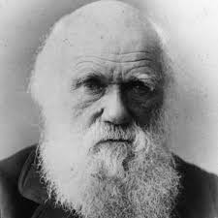
Go Farther: (Optional)
Born in Shrewsbury, England, in 1831 Charles Robert Darwin embarked on a five-year survey voyage around the world on the HMS Beagle; his studies of specimens led him to formulate his theories.
https://www.biography.com/people/charles-darwin-9266433
Notes:
Go farther in this Practice Lab: given sample syntax, build something new.

Slide 5

Challenge 2 (Optional): Add a leading phrase search-
From Challenge 1-
It was okay to use a non-tokenized key value for the initial query.
Change from marketing; that’s no longer okay.
The initial query should return the same results for; “computer mouse” or “mouse computer”, “life is good”, “good life”.
To save time, you can do all of this work on new tables, etcetera.
Notes:
Sample syntax above to harvest ideas from, and apply to the goals outlined on the page that follows.

Slide 6
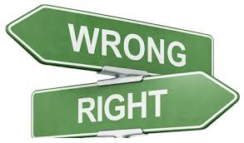
Practice Lab:
Lessons learned
Notes:
Discuss what worked well, poorly, from the Practice Lab.

Slide 7
End of Module:
Notes:
End of Practice Lab-

